Slide 1


My AI model
is better than yours…
An Introduction to AI Benchmarks
Thursday, September 17, 2026 • 4:30 PM
Andover Senior Center / Robb Center
Max Li | max@grassrootech.com | Grassrootech.com
Notes:
Opening: welcome the audience and invite them to think about how they decide whether one AI tool is better than another.
[Sources]
Grassrootech logo and speaker profile: https://www.grassrootech.com/
MMLU: https://arxiv.org/abs/2009.03300
GPQA: https://arxiv.org/abs/2311.12022
ARC-AGI: https://arcprize.org/arc-agi/2
SWE-bench: https://arxiv.org/abs/2310.06770
Humanity's Last Exam: https://doi.org/10.48550/arXiv.2501.14249
Agents' Last Exam: https://arxiv.org/abs/2606.05405

Slide 2
How many commercial AI models?
299 from artificialanalysis.ai/models
Developer country | Major model families to mention
United States (166) | OpenAI — GPT; Anthropic — Claude; Google — Gemini; Meta — Llama; xAI — Grok
China (79) | DeepSeek — V4/R1; Alibaba — Qwen; Z.ai — GLM; Moonshot AI — Kimi; MiniMax — MiniMax
South Korea (16) | LG EXAONE, Upstage Solar, and Naver HyperCLOVA X
France (11) | Mistral AI — Mistral Small, Mistral Large, Devstral
Others (27) | UAE — Falcon (TII); Israel — Jamba (AI21 Labs); Germany — Aleph Alpha
Source: Artificial Analysis, accessed September 08, 2026.
Notes:
Pause after “better at what?” Invite two or three audience responses.
[Sources]
Grassrootech logo and speaker profile: https://www.grassrootech.com/
MMLU: https://arxiv.org/abs/2009.03300
GPQA: https://arxiv.org/abs/2311.12022
ARC-AGI: https://arcprize.org/arc-agi/2
SWE-bench: https://arxiv.org/abs/2310.06770
Humanity's Last Exam: https://doi.org/10.48550/arXiv.2501.14249
Agents' Last Exam: https://arxiv.org/abs/2606.05405

Slide 3
Most AI Models are not Household Names
Popular Vendors
OpenAI (US): GPT-4.1, GPT-5, GPT-6 Astra
Anthropic (US): Claude 3.5, Claude 4, Claude Fable 5.1
Google (US): Gemini 2.5, Gemini 3, Gemini Flash / Flash-Lite
DeepSeek (China): DeepSeek-V4, DeepSeek-R1
Mistral AI (France): Mistral Small, Mistral Large, Devstral 2
Have you heard of the following ones?
Celeris-1 — listed as the catalog’s fastest output-speed model.
Mercury 2 — another very high-speed model.
Command A+ — Cohere’s enterprise-oriented model from Canada.
Granite 4.2 3B — IBM’s compact model family.
Devstral 2 — Mistral’s coding-focused model.
GLM-5.3 — a leading open-weights entry from Z.ai.
Kimi K3 — Moonshot AI’s model family from China.
Notes:
Pause after “better at what?” Invite two or three audience responses.
[Sources]
Grassrootech logo and speaker profile: https://www.grassrootech.com/
MMLU: https://arxiv.org/abs/2009.03300
GPQA: https://arxiv.org/abs/2311.12022
ARC-AGI: https://arcprize.org/arc-agi/2
SWE-bench: https://arxiv.org/abs/2310.06770
Humanity's Last Exam: https://doi.org/10.48550/arXiv.2501.14249
Agents' Last Exam: https://arxiv.org/abs/2606.05405

Slide 4
A benchmark is a report card for a particular task
It does not measure “everything about intelligence.”
It measures performance/intelligence under specific rules.
Two other aspects are equally important:
  Price
  Speed
Think of it like this:
• Spelling test
• SAT/ACT test
• Driving test
• Cooking contest
Each reveals something useful — but none tells the whole story of a person.
The first question is always: “Better at what?”
Notes:
Pause after “better at what?” Invite two or three audience responses.
[Sources]
Grassrootech logo and speaker profile: https://www.grassrootech.com/
MMLU: https://arxiv.org/abs/2009.03300
GPQA: https://arxiv.org/abs/2311.12022
ARC-AGI: https://arcprize.org/arc-agi/2
SWE-bench: https://arxiv.org/abs/2310.06770
Humanity's Last Exam: https://doi.org/10.48550/arXiv.2501.14249
Agents' Last Exam: https://arxiv.org/abs/2606.05405

Slide 5
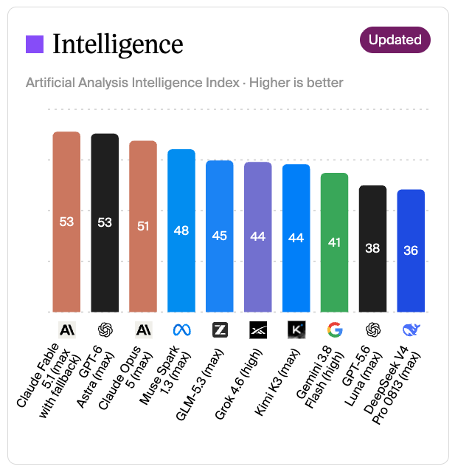
Artificial Analysis – the most popular composite benchmark of AI
Intelligence Index is calculated as a weighted average across four categories: Agents (30%), Coding (20%), Scientific Reasoning (20%) and General (30%).
Quick Data:
USA: 7
China: 3
Rest of the world: 0
OpenAI and Anthropic are in a virtual tie
Other sources put OpenAI slightly ahead of Anthropic
Notes:
Artificial Analysis Intelligence Index (AAII)
[Sources]
Grassrootech logo and speaker profile: https://www.grassrootech.com/
MMLU: https://arxiv.org/abs/2009.03300
GPQA: https://arxiv.org/abs/2311.12022
ARC-AGI: https://arcprize.org/arc-agi/2
SWE-bench: https://arxiv.org/abs/2310.06770
Humanity's Last Exam: https://doi.org/10.48550/arXiv.2501.14249
Agents' Last Exam: https://arxiv.org/abs/2606.05405

Slide 6
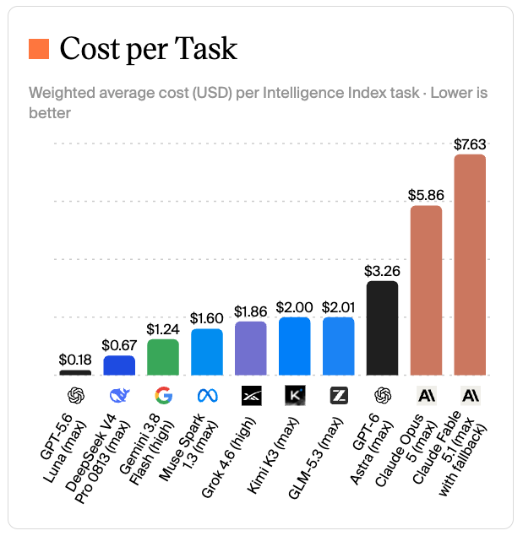
Artificial Analysis – the most popular composite benchmark of AI (3)
Quick Data:
USA: 7
China: 3
Rest of the world: 0
Google and DeekSeek are cost leaders.
Anthropic’s Claude is the most expensive one
7.63 / 0.18 = 42.39
Notes:
Artificial Analysis Intelligence Index (AAII)
[Sources]
Grassrootech logo and speaker profile: https://www.grassrootech.com/
MMLU: https://arxiv.org/abs/2009.03300
GPQA: https://arxiv.org/abs/2311.12022
ARC-AGI: https://arcprize.org/arc-agi/2
SWE-bench: https://arxiv.org/abs/2310.06770
Humanity's Last Exam: https://doi.org/10.48550/arXiv.2501.14249
Agents' Last Exam: https://arxiv.org/abs/2606.05405

Slide 7
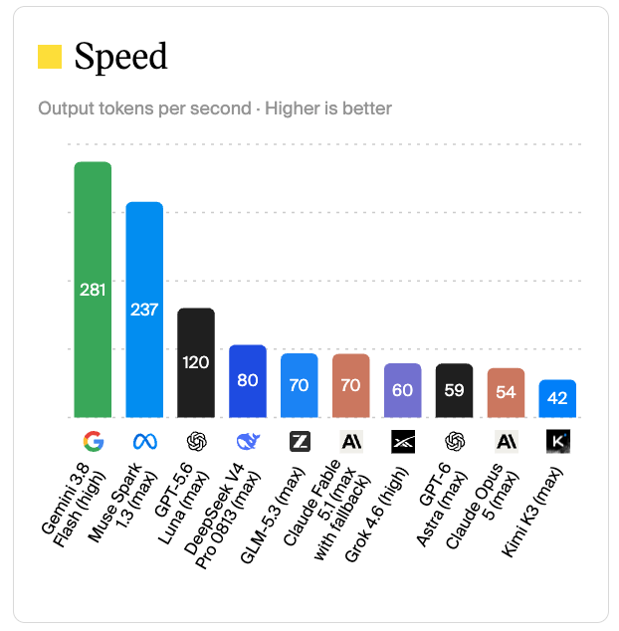
Artificial Analysis – the most popular composite benchmark of AI (2)
Quick Data:
USA: 7
China: 3
Rest of the world: 0
Google’s Gemini is the leader
281/42= 6.69
1 token ≈ ¾ of a word
100 tokens ≈ 75 words
1,000 tokens ≈ 750 words
Notes:
Artificial Analysis Intelligence Index (AAII)
[Sources]
Grassrootech logo and speaker profile: https://www.grassrootech.com/
MMLU: https://arxiv.org/abs/2009.03300
GPQA: https://arxiv.org/abs/2311.12022
ARC-AGI: https://arcprize.org/arc-agi/2
SWE-bench: https://arxiv.org/abs/2310.06770
Humanity's Last Exam: https://doi.org/10.48550/arXiv.2501.14249
Agents' Last Exam: https://arxiv.org/abs/2606.05405

Slide 8
Why scores matter — and why they can mislead
1
2
3
A score needs a task
A test can grow old
Real life is messy
A model may be excellent at explaining history, weaker at planning a trip, and unreliable at facts it has never checked.
Benchmarks are clues, not a crystal ball.
Notes:
Explain that a high score can be meaningful, but it is never the whole story.
[Sources]
Grassrootech logo and speaker profile: https://www.grassrootech.com/
MMLU: https://arxiv.org/abs/2009.03300
GPQA: https://arxiv.org/abs/2311.12022
ARC-AGI: https://arcprize.org/arc-agi/2
SWE-bench: https://arxiv.org/abs/2310.06770
Humanity's Last Exam: https://doi.org/10.48550/arXiv.2501.14249
Agents' Last Exam: https://arxiv.org/abs/2606.05405

Slide 9
Six scorecards for six kinds of ability
GPQA
Graduate-Level Google-Proof Q &A
ARC-AGI
Abstraction and Reasoning Corpus for Artificial General Intelligence
MMLU
Massive Multitask Language Understanding
Hard science
Broad knowledge
SWE-bench
Software Engineering benchmark
New puzzles
HLE
Humanity’s Last Exam
ALE
Agent’s Last Exam
Fixing software
Expert questions
Long practical work
Notes:
Transition: each benchmark is like a different kind of exam.
[Sources]
Grassrootech logo and speaker profile: https://www.grassrootech.com/
MMLU: https://arxiv.org/abs/2009.03300
GPQA: https://arxiv.org/abs/2311.12022
ARC-AGI: https://arcprize.org/arc-agi/2
SWE-bench: https://arxiv.org/abs/2310.06770
Humanity's Last Exam: https://doi.org/10.48550/arXiv.2501.14249
Agents' Last Exam: https://arxiv.org/abs/2606.05405

Slide 10
MMLU asks: “How broad is the model’s school knowledge?”
MMLU = Massive Multitask Language Understanding
Math
History
Law
Medicine
Computer science
Philosophy
It covers 57 subjects. A useful broad quiz — but broad knowledge is not the same as good judgment.
Notes:
MMLU is a 57-subject academic and professional knowledge test. Ask: Would an excellent trivia player necessarily make the best doctor or financial adviser?
[Sources]
Grassrootech logo and speaker profile: https://www.grassrootech.com/
MMLU: https://arxiv.org/abs/2009.03300
GPQA: https://arxiv.org/abs/2311.12022
ARC-AGI: https://arcprize.org/arc-agi/2
SWE-bench: https://arxiv.org/abs/2310.06770
Humanity's Last Exam: https://doi.org/10.48550/arXiv.2501.14249
Agents' Last Exam: https://arxiv.org/abs/2606.05405

Slide 11
GPQA asks: “Can the model handle very difficult science?”
Graduate-level questions in biology, physics, and chemistry — written by experts.
“Google-proof”
448 questions
A different skill
Designed so that looking up a quick answer is not enough.
Small set, very difficult.
More like a difficult oral exam than a written quiz.
A model can score well on easy questions and still struggle here.
Notes:
GPQA contains 448 difficult multiple-choice science questions. Emphasize: it tests a narrow but important slice of ability.
[Sources]
Grassrootech logo and speaker profile: https://www.grassrootech.com/
MMLU: https://arxiv.org/abs/2009.03300
GPQA: https://arxiv.org/abs/2311.12022
ARC-AGI: https://arcprize.org/arc-agi/2
SWE-bench: https://arxiv.org/abs/2310.06770
Humanity's Last Exam: https://doi.org/10.48550/arXiv.2501.14249
Agents' Last Exam: https://arxiv.org/abs/2606.05405

Slide 12
ARC-AGI asks: “Can it solve a new kind of puzzle?”
Instead of memorizing facts, the model must discover a rule from examples and apply it to a new case.
Example
New puzzle
The point is not the colored squares. The point is adapting to a rule you have not seen before.
Notes:
Use the simple color pattern only as an illustration, not an actual ARC task. ARC-AGI is intended to test new problem-solving and adaptation.
[Sources]
Grassrootech logo and speaker profile: https://www.grassrootech.com/
MMLU: https://arxiv.org/abs/2009.03300
GPQA: https://arxiv.org/abs/2311.12022
ARC-AGI: https://arcprize.org/arc-agi/2
SWE-bench: https://arxiv.org/abs/2310.06770
Humanity's Last Exam: https://doi.org/10.48550/arXiv.2501.14249
Agents' Last Exam: https://arxiv.org/abs/2606.05405

Slide 13
SWE-bench
The task: read a bug report, understand a codebase, make a repair, and pass the tests.
1
2
3
4
→
→
→
Bug report
Read the code
Make a change
Run tests
This is closer to useful work — but it still tests only a particular kind of work.
Notes:
SWE-bench uses real GitHub issues and associated pull requests from Python projects. Mention that a passing test suite is a clear, checkable result.
[Sources]
Grassrootech logo and speaker profile: https://www.grassrootech.com/
MMLU: https://arxiv.org/abs/2009.03300
GPQA: https://arxiv.org/abs/2311.12022
ARC-AGI: https://arcprize.org/arc-agi/2
SWE-bench: https://arxiv.org/abs/2310.06770
Humanity's Last Exam: https://doi.org/10.48550/arXiv.2501.14249
Agents' Last Exam: https://arxiv.org/abs/2606.05405

Slide 14
Humanity’s Last Exam raises the difficulty even further
A challenging collection of expert-level questions across many academic areas.
Mathematics
Computing
Science
HLE
Engineering
Humanities
Even a very hard test is not a final verdict on intelligence.
Notes:
HLE was created as an expert-level academic benchmark with broad subject coverage. Avoid quoting changing leaderboard scores; focus on what it measures.
[Sources]
Grassrootech logo and speaker profile: https://www.grassrootech.com/
MMLU: https://arxiv.org/abs/2009.03300
GPQA: https://arxiv.org/abs/2311.12022
ARC-AGI: https://arcprize.org/arc-agi/2
SWE-bench: https://arxiv.org/abs/2310.06770
Humanity's Last Exam: https://doi.org/10.48550/arXiv.2501.14249
Agents' Last Exam: https://arxiv.org/abs/2606.05405

Slide 15
Agents’ Last Exam asks: “Can an AI keep going on a practical job?”
Long, professional tasks with results that can be checked.
A newer benchmark (June 2026)
Challenge and measure AI agents on economically valuable and real-world tasks.
Plan
→
Research
→
Work
→
Verify
One mistake early in a long task can affect everything that follows.
This is why “agent” benchmarks are different from one-question exams.
Notes:
ALE measures long-horizon, economically valuable tasks with verifiable outcomes. Explain “long-horizon” as a multi-step task where the AI must keep track of progress.
[Sources]
Grassrootech logo and speaker profile: https://www.grassrootech.com/
MMLU: https://arxiv.org/abs/2009.03300
GPQA: https://arxiv.org/abs/2311.12022
ARC-AGI: https://arcprize.org/arc-agi/2
SWE-bench: https://arxiv.org/abs/2310.06770
Humanity's Last Exam: https://doi.org/10.48550/arXiv.2501.14249
Agents' Last Exam: https://arxiv.org/abs/2606.05405

Slide 16
Can you ”Cheat” on benchmark score?
Short answer: Yes. But a surprising score is not proof.
How a score can be misleading | Plain-English explanation
Test leakage | The model saw test questions or answers during training—like getting the exam in advance.
Optimizing for one test | A model, prompt, tool setup, or extra “thinking” budget is tuned specifically for the benchmark.
Reporting a different version | The company highlights a score from a special test variant, while the public version performs differently.
Unequal test conditions | One model gets more retries, tools, compute, or a more favorable prompt.
DeepSeek and Meta’s Llama models have been questioned.
No concrete cheating evidence.
Notes:
ALE measures long-horizon, economically valuable tasks with verifiable outcomes. Explain “long-horizon” as a multi-step task where the AI must keep track of progress.
[Sources]
Grassrootech logo and speaker profile: https://www.grassrootech.com/
MMLU: https://arxiv.org/abs/2009.03300
GPQA: https://arxiv.org/abs/2311.12022
ARC-AGI: https://arcprize.org/arc-agi/2
SWE-bench: https://arxiv.org/abs/2310.06770
Humanity's Last Exam: https://doi.org/10.48550/arXiv.2501.14249
Agents' Last Exam: https://arxiv.org/abs/2606.05405

Slide 17
The same model can look different on different tests
Imagine three imaginary models. Which is “best”?
Model A
Excellent at knowledge quizzes
Weak at new puzzles
Model B
Strong at science reasoning
Average at practical work
Model C
Good at coding tasks
Needs fact-checking
“Best” depends on your purpose — just as you would choose different people for different jobs.
Notes:
Use this as a conversation slide. The “models” are intentionally fictional and have no scores.
[Sources]
Grassrootech logo and speaker profile: https://www.grassrootech.com/
MMLU: https://arxiv.org/abs/2009.03300
GPQA: https://arxiv.org/abs/2311.12022
ARC-AGI: https://arcprize.org/arc-agi/2
SWE-bench: https://arxiv.org/abs/2310.06770
Humanity's Last Exam: https://doi.org/10.48550/arXiv.2501.14249
Agents' Last Exam: https://arxiv.org/abs/2606.05405

Slide 18
A practical checklist before trusting an AI tool
1
What task do I need help with?
2
Does this test resemble that task?
3
Can I check the answer before acting on it?
4
What happens if it is wrong?
5
What private information am I sharing? Am I comfortable with that?
Use AI as a helpful assistant — not as an unquestioned authority.
Notes:
Encourage participants to use this checklist for any AI they try.
[Sources]
Grassrootech logo and speaker profile: https://www.grassrootech.com/
MMLU: https://arxiv.org/abs/2009.03300
GPQA: https://arxiv.org/abs/2311.12022
ARC-AGI: https://arcprize.org/arc-agi/2
SWE-bench: https://arxiv.org/abs/2310.06770
Humanity's Last Exam: https://doi.org/10.48550/arXiv.2501.14249
Agents' Last Exam: https://arxiv.org/abs/2606.05405

Slide 19
Try a small benchmark of your own
Ask two AI tools the same useful question.
Example
Compare
Decide
“Please explain my cell phone bill in plain English. Tell me which charges I should ask about.”
• Clear?
• Accurate?
• Honest about uncertainty?
• Easy to follow?
Which one helped you more — and why?
Notes:
Invite participants to suggest another everyday question. Stress: do not enter private information.
[Sources]
Grassrootech logo and speaker profile: https://www.grassrootech.com/
MMLU: https://arxiv.org/abs/2009.03300
GPQA: https://arxiv.org/abs/2311.12022
ARC-AGI: https://arcprize.org/arc-agi/2
SWE-bench: https://arxiv.org/abs/2310.06770
Humanity's Last Exam: https://doi.org/10.48550/arXiv.2501.14249
Agents' Last Exam: https://arxiv.org/abs/2606.05405

Slide 20
The takeaway
Benchmark scores are useful evidence.
They are not the whole story.
Ask “better at what?”
Best way: try tools on your own real tasks.
Keep your taste/judgment in the loop.
Questions & conversation
Notes:
Close by restating the central takeaway and invite questions. Mention Max Li, founder of Grassrootech.com, focused on AI-powered website creation and promotion.
[Sources]
Grassrootech logo and speaker profile: https://www.grassrootech.com/
MMLU: https://arxiv.org/abs/2009.03300
GPQA: https://arxiv.org/abs/2311.12022
ARC-AGI: https://arcprize.org/arc-agi/2
SWE-bench: https://arxiv.org/abs/2310.06770
Humanity's Last Exam: https://doi.org/10.48550/arXiv.2501.14249
Agents' Last Exam: https://arxiv.org/abs/2606.05405

